Slide 1
SUPPORTING SCHOOLS AND STUDENTS TO ACHIEVE
Meeting the Unique Needs of Migrant Students: The Heart Behind the Data
Tamara Lawson
Migrant Education Program Coordinator
Caldwell School District
Genoveva Winkler
Migrant Regional Coordinator
¡Bienvenidos!

Slide 2
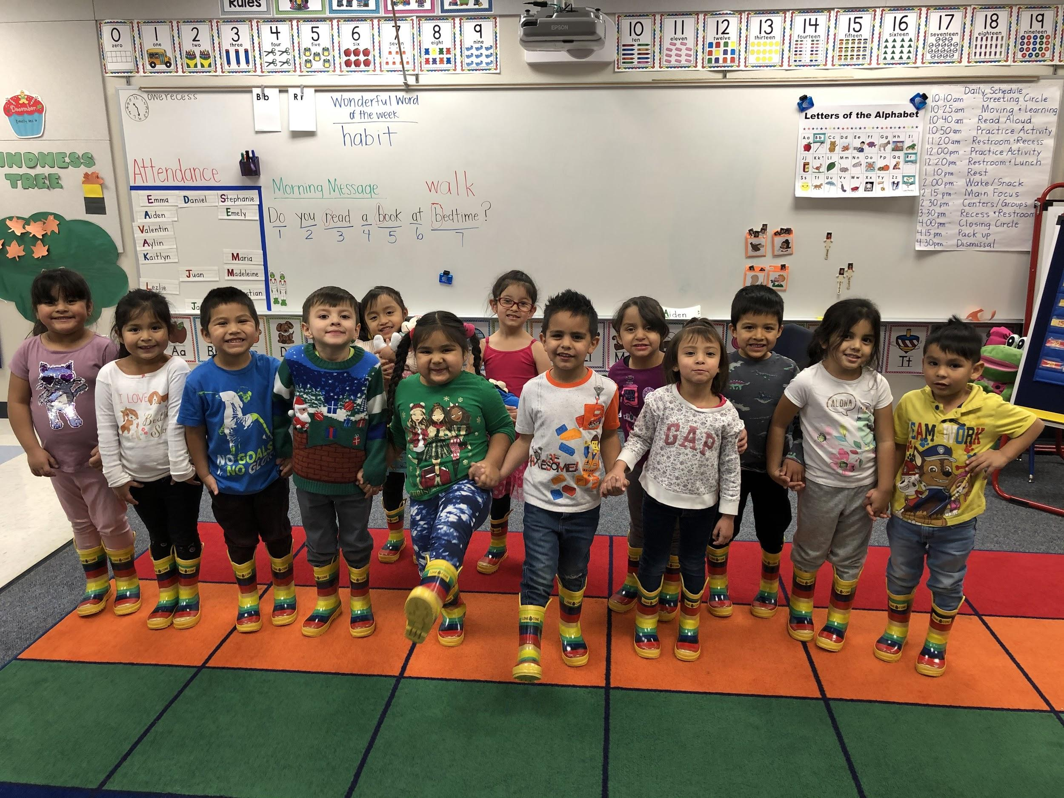
SUPPORTING SCHOOLS AND STUDENTS TO ACHIEVE

Slide 3
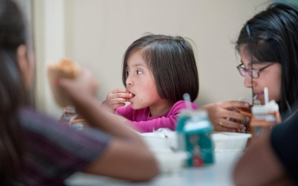
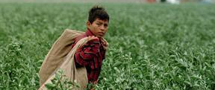
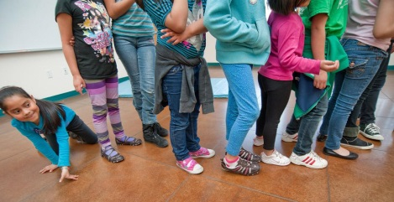
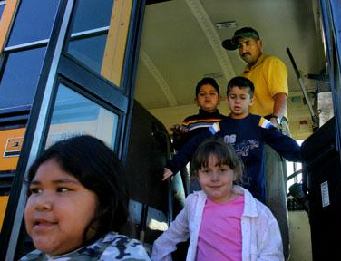
Objectives
Participants will explore the needs of migrant students
Participants will find solutions to challenges faced by migrant students
SUPPORTING SCHOOLS AND STUDENTS TO ACHIEVE

Slide 4
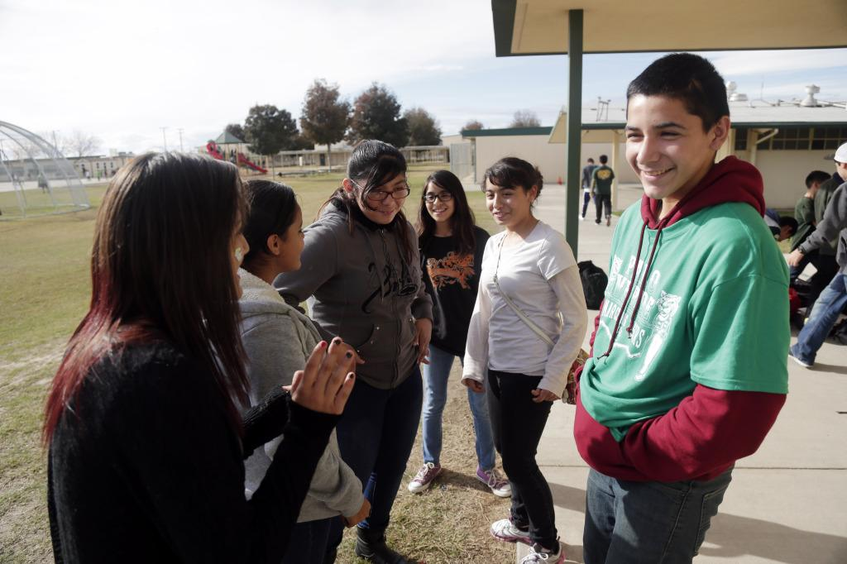
Identifying Migrant Needs

Slide 5
7 Areas of Concern
The 7 areas of concern reflect areas known to affect migrant students.
They are not an exhaustive list, but are fairly broad.
They help us identify the concerns that we should be looking for.
SUPPORTING SCHOOLS AND STUDENTS TO ACHIEVE

Slide 6
Activity:
As you watch the video, take notes and consider these questions:
What needs can you identify or can infer from the student’s situations?
How would you know they have these needs if you worked with one of them?
SUPPORTING SCHOOLS AND STUDENTS TO ACHIEVE

Slide 7
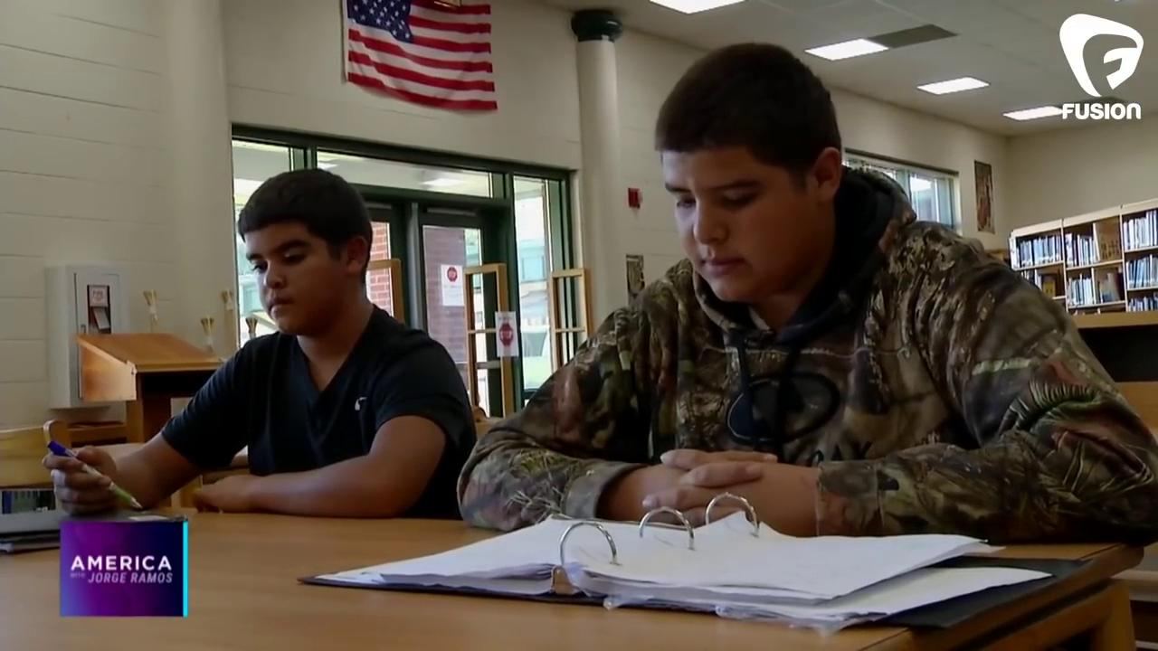
Activity:
SUPPORTING SCHOOLS AND STUDENTS TO ACHIEVE

Slide 8
Sharing
Share your thoughts on the needs of these children
What did you notice?
What do you wonder?
SUPPORTING SCHOOLS AND STUDENTS TO ACHIEVE

Slide 9
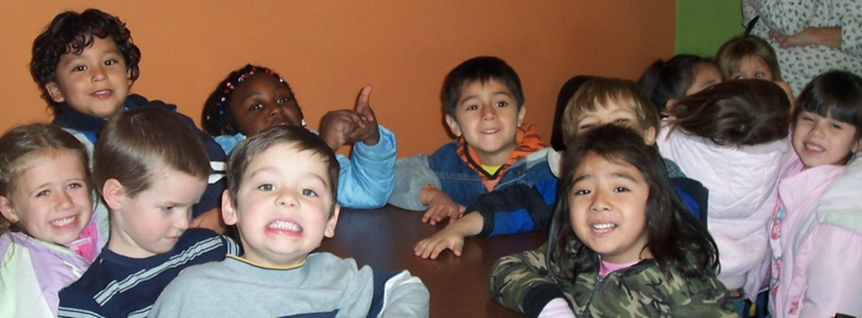
Migrant Services

Slide 10
Services in the Migrant program
Referrals
Extended Services
Instructional Services
Support Services
Summer School
SUPPORTING SCHOOLS AND STUDENTS TO ACHIEVE
Notes:
Referrals: are for non-migrant funded services to give access to community support/agency services. Some examples of referred services are referrals to food banks, Toys-for-Tots, Lions Club for glasses, community clinics, food backpacks, etc.
Extended: after school programs
Instructional: rare
Support: graduation specialists, school supply backpacks Advocacy for migrant children
Health, nutrition, or social services
Necessary educational supplies
Transportation

Slide 11
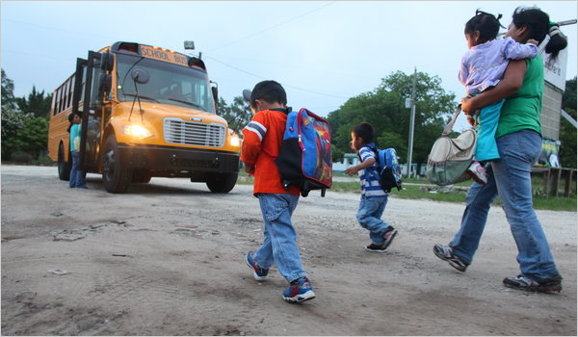
How We Help Migrant Children

Slide 12
Activity
Read scenarios (2) for elementary students
Add needs to graphic organizer
Brainstorm Solutions
What can the school do to meet needs?
How can the school staff collaborate with the migrant program to meet needs?
SUPPORTING SCHOOLS AND STUDENTS TO ACHIEVE

Slide 13
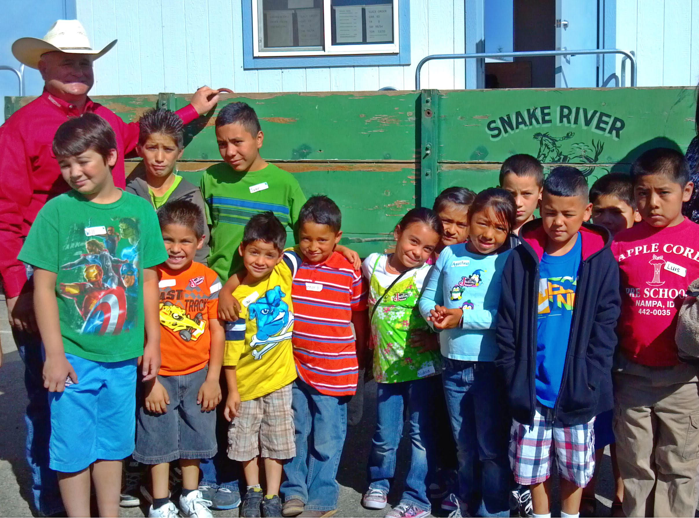
Empowering migrant students and their families to succeed in Idaho.

Slide 14
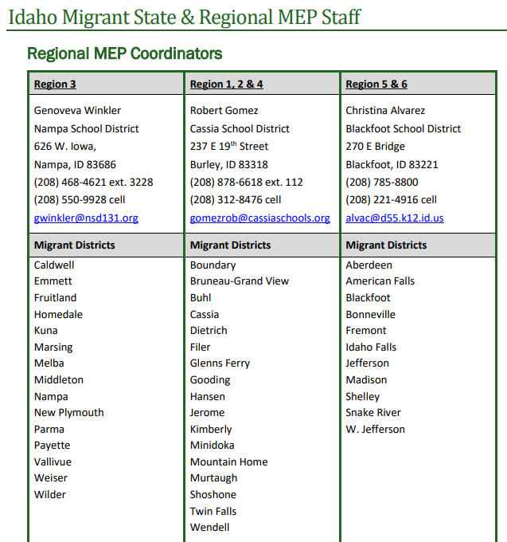
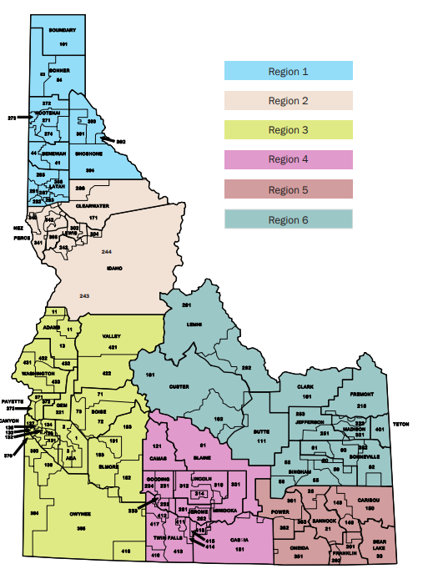
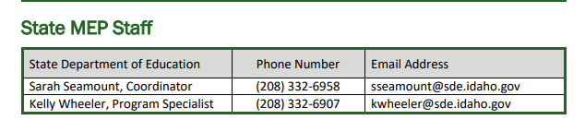
Migrant Contacts
SUPPORTING SCHOOLS AND STUDENTS TO ACHIEVE

