Slide 1
Restorative Practices in the Classroom: A practical guide to facilitating community circles and harm circles
Jessica Johnson
Junior High Science Teacher
jessjohn1988@gmail.com

Slide 2
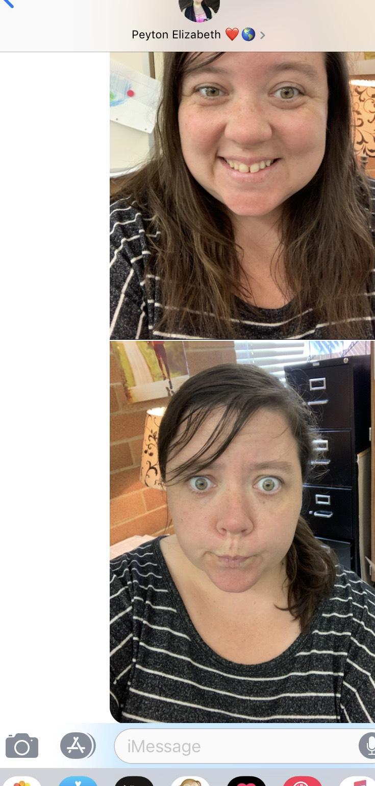
Who am I and what lead me here?
7th Grade/ 8th Grade Science Teacher
Previously taught 6th
Second year of teaching
These two pictures depict the mood I often felt my first year teaching…. Until I changed my game.
Notes:
My first year, I had a classroom of 6th graders who were very emotional. A few of the students were self-harming and one attempted suicide on the playground four times. I found myself exhausted in the middle of the year and ready to be done. I needed to do something different

Slide 3
What are restorative practices?
Proactively developing community and relationships
Repairing the harm in the community
Based off “Restorative Justice” - system of indigenous people to repair harm
Notes:
*based on the idea that the well-being of a community and its members is preserved through communication, emotional connection, understanding and meaningful relationships. An underlying principle of Restorative Justice is that crime or wrongdoing causes harm, and that true justice involves repairing that harm and restoring the relationships that were affected by it. This is in contrast to most justice systems today, which focus on crime as a violation of the law or a rule, rather than a violation against a person and against peace in the community. RJ in schools started in the late 90’s when it was noticed that traditional school approaches were not working.

Slide 4
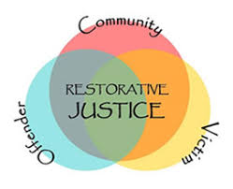
Restorative practices help us reach the “difficult students” and lead to real, lasting change within a school culture.
“The Ultimate classroom management tool”
Notes:
Students are going to misbehave; it’s what we do with that misbehavior that helps us learn and grow
Restorative practices is an offshoot to a current “restorative justice” approach used in courtrooms and law-enforcement agencies around the world
Mutually consenting victims and offenders meet so that the former can be given a voice and the latter can have an opportunity to make amends
This also empowers communities
Restorative Practices includes preventative measures designed to build skills and capacity in students and adults as well
It’s harder for students to act defiantly or disrespectfully toward adults who clearly care about them and their future

Slide 5
Traditional School Approach | Restorative Approach
Schools and rules are violated | People and relationships are violated
Justice Focuses on establishing guilt | Justice identifies needs and obligations
Accountability is defined as punishment | Accountability is defined as understanding the effects of the offense and repairing any harm
Justice is directed at the offender, the victim is ignored | The offender, victim, and school all have direct roles in the justice process
Rules and intent outweigh the outcome | Offenders are held responsible for their behavior, repairing any harm they’ve caused and working toward a positive outcome
No opportunity is offered for the offender to express remorse or make amends | Opportunities are offered for offenders to express remorse and make amends
Notes:
Core idea; students are not inherently troubled. Something has happened to cause that trouble. We dive into the behavior just as we dive into an academic disability. RP helps to: Reduce crime/violence/bullying, improve human behavior, strengthen civil society, provide effective leadership, restore relationships, and repair harm

Slide 6
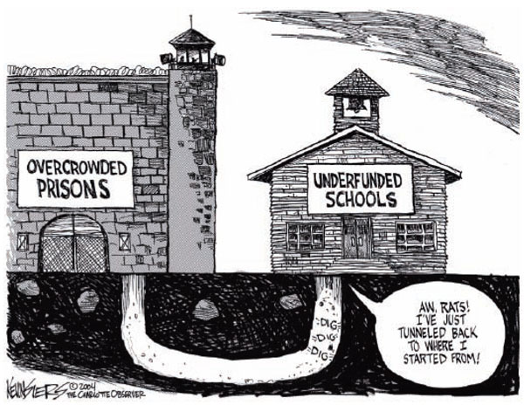
Notes:
School to prison pipeline: According to the Civil Rights Data Collection: of the 49 million students enrolled in public schools, in 2011-2012, 3.5 million were suspended in school, 3.45 million out of school, and 130,000 were expelled. Black students are suspended and expelled 3xs as often as white students and students with disabilities are suspended twice as often as their non-disabled peers. When a student is removed from the education setting, they are at risk of entering the juvenile justice system or even prison (often referred to as the school to prison pipeline)

Slide 7
The “School To Prison Pipeline”
49 million students enrolled in public schools, in 2011-2012,
3.5 million were suspended in school
3.45 million out of school
130,000 were expelled
Students of color are suspended and expelled 3xs as often as their caucasian peers.
Students with disabilities are suspended twice as often as their non-disabled peers.
When a student is removed from the education setting, they are at risk of entering the juvenile justice system or even prison (often referred to as the school to prison pipeline)

Slide 8
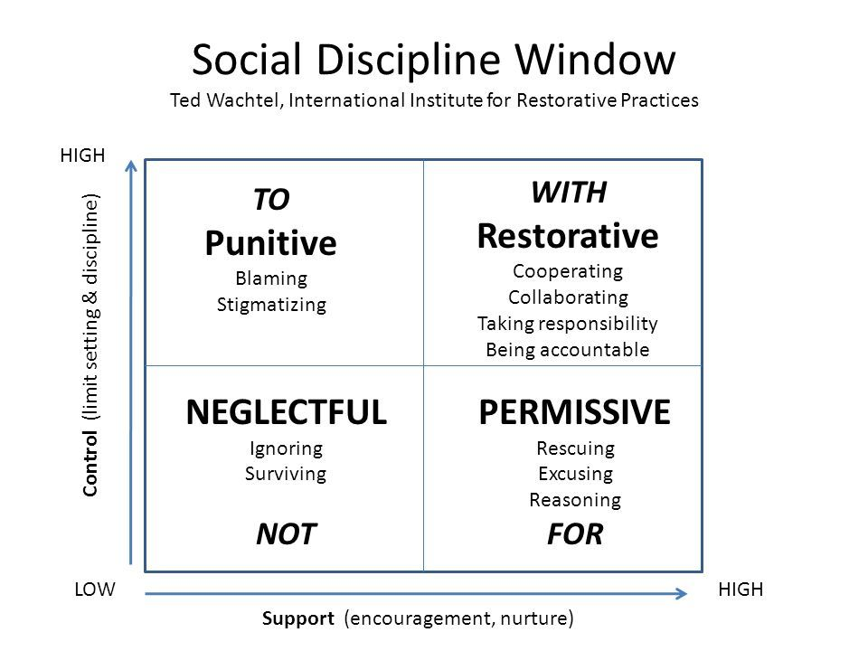

Slide 9
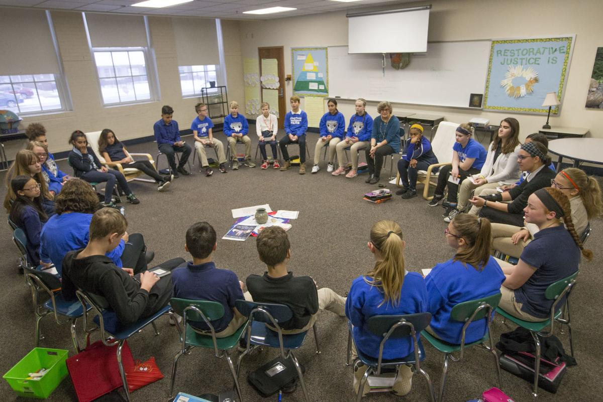
The key take away is school is a community.
Notes:
Relationships are the heart of our school communities, and we must work diligently to build, strengthen, and restore these relationships. This means we must first use Restorative Practices pro-actively by providing all members of the community with voice, respect, and acceptance. While we often focus on how to respond after harm is done, we cannot “restore” a community when the community was not built in the first place.

Slide 10
Restorative Practices Video

Slide 11
Restorative Mindsets (Think Growth Mindsets)
Relationships and trust are at the center of community
All members of the community are responsible to and for each other
Multiple perspectives are welcomed and all voices are equally important
Healing is a process essential to restoring community
Harm-doers should be held accountable for and take an active role in repairing harm
Conflict is resolved through honest dialogue and collaborative problem-solving that addresses the root cause and the needs of those involved
Notes:
A restorative mindset describes how a person understands community and one’s role in the community. The values and concepts that underlie a restorative mindset include:

Slide 12
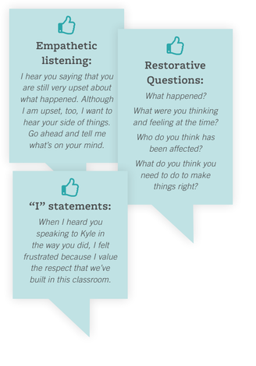
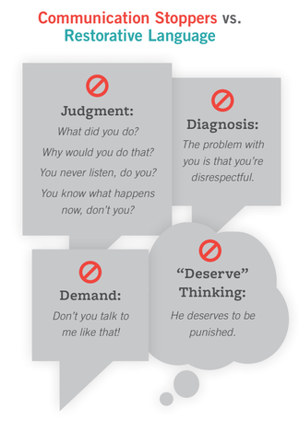
Restorative Language

Slide 13
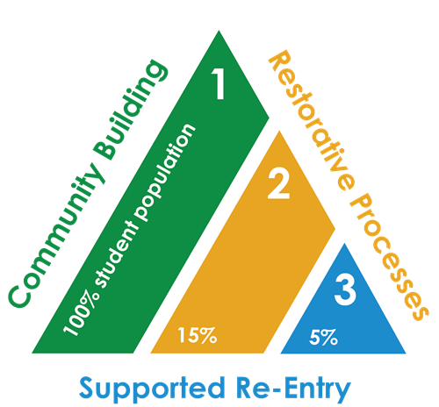
Tier 1: Restorative practices in Schools/Classrooms
*Positive Behavior Intervention Supports (PBIS)
Tier 2: Small groups with class/parties involved
Tier 3: Least frequent intervention, intimate setting
*Goal is to keep the student in school
*All stakeholders meet
*Alternatives to suspension
Notes:
Teir 1 Examples: *Agreed upon classroom/school goals/expectations
*Connection Circles
*Relationship building
Tier 2: *Once a week with RJ team leader, supporting staff
* Harm circles (non-intensive), conflict management
*Counseling services available/suggested
*Restorative supports (mentoring, etc)

Slide 14
Community/Connection circles
Establish Norms/rules of respect
Enforce rules consistently
Squash side conversations immediately
Have a talking piece

Slide 15
Examples of Community Circle Norms
Speak from the Heart- Say only what is true to you
Listen from the heart- no side conversations, giving the speaker your eye contact and attention
No need to rehearse- Trust that you will know what to say when the time comes for you to talk
Say just enough - we have an end time and we want everyone to be able to say what they need to say.

Slide 16
Set-Up
Have an important talking piece
Mindful breathing
Have students take a deep breath in and out, repeat as you need
Go over norms
Open with a poem, a quote, or a song lyric
Start with low-risk questions
Eventually, move to bigger and deeper questions
Throughout circle, praise students who are open and honest/demonstrate empathy/etc
End circle by thanking the participants

Slide 17
Overcoming Pushback
“Circles take away from lesson time”
“This takes too long”
Notes:
Time: yes, they do. By far the largest con of anything is never enough time. BUT it is a power move. You’ll spend a little more time getting them used to it, but then it really just takes off. You have to weigh your priorities and determine its worth. Eventually you see students holding eachother accountable and that adds time back to your lesson
Too Long: Investment in the classroom climate and school culture isn’t instant. Building a culture does absolutely take time but it’s worht it

Slide 18
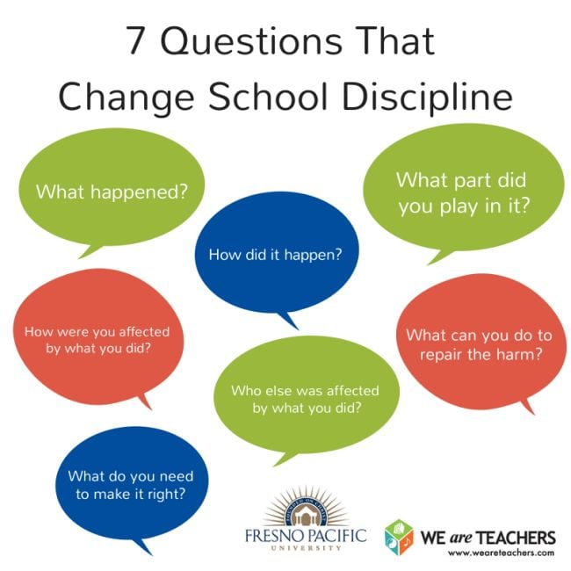
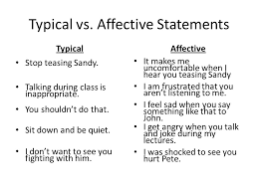
Harm/Conflict Circles
Notes:
Deal with issues in the classroom if you can. When a student is removed from the classroom because of negative behavior they are no longer held accountable for the impact the behavior had on the class

Slide 19
Harm/Repair Circles
The main questions are:
What happened
What were you thinking about at the time of the event?
Who has been affected by the behavior?
What will you do to fix this?
Notes:
Scenario: Asher throws a pencil at caleb from across the room.

Slide 20
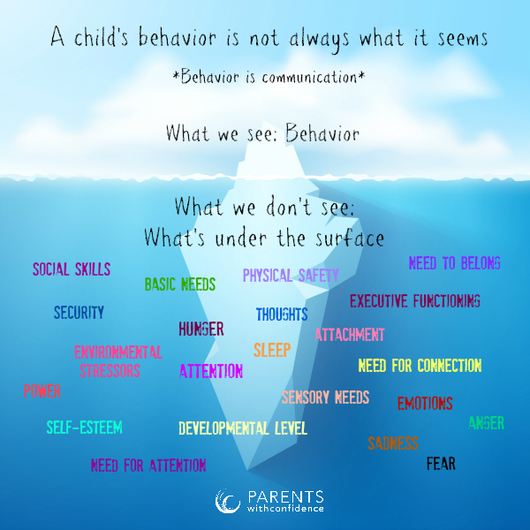
Step 1: Delve into the behavior
*Open ended questions
* Affirm students who take responsibility
* Look for the reason for the issue, not just the issue
* Don’t dismiss behavior/excuse it, but use it to understand why
Notes:
“Asher I saw you throw the pencil. What were you thinking when you did that” Asking open ended questions might help you realize: He found out his parents are getting a divorce, his girlfriend broke up with him… etc. he has no clue how to do polynomials and is afraid he will fail the test next week

Slide 21
Step 2: Identify the stakeholders
Ask the student to identify who the affected parties were
Keep it open ended
Have student identify HOW each person is affected
Notes:
Affected parties were: Asher, teacher, parents, other student, class
Lead student through this, but don’t give them answers. This is the cognitive component of empathy development: now they have to think about someone else’s perspective!

Slide 22
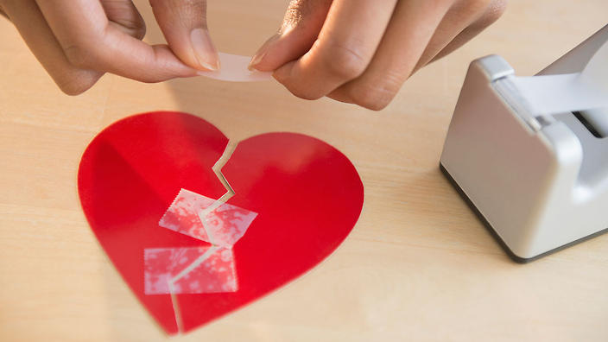
Step 3: Repair the harm
Still guiding the student with open ended questions, but not telling them the answer
For true learning to occur and for behavior to change long-term, you want this to come from the student with your guidance
Notes:
So you said that the class stopped paying attention and laughed…. How can we fix this? “I dont know.” “Well. Let’s think about it. They all stopped paying attention and laughed. What if someone was really behind and needed this lesson? Or what if some of them will now be off-task for the rest of the class because they were distracted after seeing you throw a pencil. What about how your classmates would have felt if they accidently got hit” ….. “I understand you feel you can’t fix this. But we can repair this. What are a couple of ways you can speak to everyone in the class at the same time?” “Talk to the whole class”

Slide 23
Step 4: Reintegrate
Once the student has repaired the harm, they need to be reintegrated into a routine
For every redirection, there should be three affirmations ideally the same day
Remember: RELATIONSHIPS ARE EVERYTHING!
Notes:
“Asher did a great job of apologizing. Let’s continue where we left off. Just remember, we are in this together”

Slide 24
Overcoming Pushback
“I can’t find the time”
“ This isn’t my job”
“ This won’t work”
“This won’t work for all students”
“It’s too complicated”
Notes:
Time: if you don’t full resolve an issue, offer closure, or create a plan, you will eventually have to spend time dealing with it again
Job: Student success IS our job. Relationships with all people in the building is essential
Work: “students just fake it” They could. But it doesn’t have to be that way. You are able to ask open ended questions like “how are you feeling” and it’s hard to fake it.
For all: nope. It might not. Students are unique and so are the specific circumstances that led to the conflict. But the current punitive system isn’t a one-size fits all either. RP develops empathy at an exponential rate and strengthens relationships like nothing else and it has better chances of reaching all students than the current punitive system
Complicated; sending students to the office is easier. But they come back the same. Or even worse. It also changes your classroom when a student is sent out and harm isn’t prepared Sometimes you do still send students, but you can still restore relationships

Slide 25
I’ll let the data speak for itself….
• Denver Public Schools report that students who participated in an RJ program experienced a 50% reduction in absenteeism and a decrease in tardiness of about 64 % (Baker, 2009).
• Oakland Unified School District (OUSD) Scholastic Reading Inventory (SRI) levels in grade 9 doubled in RJ high schools from an average of 14% to 33% (Jain, et. al., 2014).
• Cole Middle School’s California State Test (CST) scores went up by 74 points from school year 2007/08 to 2008/09 (Kidde & Alfred, 2011).
• In Ed White Middle School (TX), the number of students who passed the standardized reading and math components increased substantially (Armour, 2014).
• RJ High Schools within OUSD had a 59.9% increase in 4 year graduation rates (OUSD, 2015a)
• Oakland Middle Schools that implemented RJ had a 24% reduction in chronic absence (OUSD, 2015b); High Schools that implemented RJ experienced a 56% decline in high school dropout rates in comparison to 17% for non-RJ high schools (Jain, et. al., 2014).

Slide 26
• Two Minneapolis Public Schools significantly reduced behavioral referrals and suspensions using circle in the classroom and circle to repair harm in the office, by 45% to 63% (Minnesota DOE, 2003, 2011)
• When Family Group Conferences were used as a restorative intervention strategy for responding to serious behavioral incidents (recommendations for expulsion or administrative transfer) in Minneapolis Public Schools, 97% of parents said they would recommend the program to a friend and high levels of satisfaction were reported by both students and parents/guardians (McMorris et. al., 2013).
• At Cole Middle School in Oakland, CA suspensions declined dramatically by 87% and expulsions declined to zero during the implementation of whole school restorative justice (Sumner et. al, 2010).
• In Palm Beach County, FL, two schools saw 130-300 day reductions in suspension days (Schiff, 2012).
• In San Antonio, TX, Ed White Middle School implemented RJ in 2012; In-school suspensions for conduct violations dropped by 65% - 47% in 2013/14. Out of school suspensions dropped 57% - 35% (Armour, 2014).

Slide 27
“Either we spend time meeting a child’s emotional needs by filling their cup with love or we spend time dealing with the behaviors caused by their unmet needs. Either way, we spend the time.”
Pam Leo, author of Connection Parenting

Slide 28
References Advancement Project. (2010). Test, Punish, And Push Out: How Zero Tolerance And HighStakes Testing Funnel
Youth Into The School To Prison Pipeline. Washington, D.C.: Author. Armour, M. (2014) Ed White Middle School Restorative Discipline Evaluation: Implementation and Impact,
2013/2014. The Institute for Restorative Justice and Restorative Dialoggue, The University of Texas at Austin. Baker, M. (2009). DPS Restorative Justice Project: Year three. Denver, CO: Denver Public Schools. Encarnacao, J. (Sept., 3, 2013) approach. Sharp Drop in Suspensions as Boston Schools Try Restorative. Boston
Herald. Retrieved on June 8, 2015 from: http://csgjusticecenter.org/youth/media-clips/sharp-drop-in-suspensions-as- boston-schools-try-restorative-approach/ Gregory A., Clawson, K., Davis, A., & Gerewitz, J. (2014). The promise of restorative practices to transform
teacher-student relationships and achieve equity in school discipline. Journal of Educational and Psychological Consultation. Jain, S., Bassey, H. ,Brown, M. and Kalra, P. (2014) Restorative Justice in Oakland Schools: Implementation and
Impacts. Retrieved on June 8, 2015 from: http://www.ousd.k12.ca.us/cms/lib07/CA01001176/Centricity/Domain/134/OUSD- RJ%20Report%20revised%20Final.pdf Kidde, J., & Alfred, R. (2011). Restorative Justice: A working guide for our schools. Alameda County Health Care
Services. Lewis, S. (2009) Improving School Climate: Findings from Schools Implementing Restorative Practices. Retrieved
on October 31, 2014 from: http://www.iirp.edu/pdf/IIRP-Improving-School-Climate.pdf McMorris, B.J., Beckman, K.J., Shea, G., Baumgartner, J., & Eggert, R.C. (2013). Applying Restorative Justice
Practices to Minneapolis Public Schools Students Recommended for Possible Expulsion: A Pilot Program Evaluation of the Family and Youth Restorative Conference Program. School of Nursing and the Healthy Youth Development. Prevention Research Center, Department of Pediatrics, University of Minnesota, Minneapolis, MN. Minnesota Department of Education. (2003). Restorative School Grant Executive Summary. Minnesota: Minnesota
Department of Education. Minnesota Department of Education. (2011). Restorative Measures In Schools Survey, 2011 Executive Summary.
Minnesota: Minnesota Department of Education. Oakland Unified School District (2015a) OUSD Aeries Scorecard Data File. Oakland, CA: Oakland Unified School
District. Retrieved on February 2, 2016 from: http://www.ousd.org/Page/12332 Oakland Unified School District (2015b) OUSD Aeries Data 2011 – 2014 Scoreboard Data File. Oakland, CA:
Oakland Unified School District. Retrieved on February 2, 2016 from: http://www.ousd.org/Page/12331 Schiff, M. (2013) Dignity, Disparity and Desistance: Effective Restorative Justice Strategies to Plug the “School-to- Prison-Pipeline” In Center for Civil Rights Remedies National Conference. Closing the School to Research Gap: Research to Remedies Conference. Washington, DC. Sumner, M., Silverman, C., and Frampton, M. (2011) School-based Restorative Justice as an Alternative to Zero-
tolerance Policies: Lessons from West Oakland. Thelton E. Henderson Center for Social Justice, University of California, Berkeley, School of Law.
Compiled on March 1, 2016 by Jon Kidde, Green Omega, L3C, PO Box 23, Vergennes, VT 05491 JonKidde@GreenOmegaL3C.org

