Slide 1
Supporting Teachers Supports Students: ELL Teachers as Peer Consultants
Kim Allen M.Ed.
Brent Rogers M.HRTD
Sara Toledo M.Ed

Slide 2
“War Stories”
With elbow partner you don’t work with
Share the last “crisis” a teacher approached you with about one of their ELL students.
What was the concern?
Where did the conversation happen?
When did it happen?
Was it resolved?
Share out
Notes:
Share out (write themes of crises: schedules, tests, understanding. Etc…)

Slide 3
Goals for Session
Discuss historical role of ELL teacher as educator and support for peers
Understand program model of Canyon Ridge High School.
Discuss ideas for incorporating peer consulting in your own school.

Slide 4
Table Partner
What are the expectations and responsibilities of your school’s ELL teacher(s)?
What tasks of the ELL teacher differ from other teachers in the school?
What was your ELL program 20 years ago? 10 years ago? Now?

Slide 5
Evolution of educational collaboration
Individualism
Collectivism
Student
ELL Teacher
ELL teacher
Administrator
Content Teacher
Student
Content Teacher
Administrator
Notes:
Discuss educational evolution of teachers as managers of students to teachers as directors and collaborates of student-centered learning.

Slide 6
About our school:
Canyon Ridge High School
ELL Population
One of two high schools in district
Only high school ELL program in district
60% free and reduced lunch
Student body – 1,200
Teachers - 60
Instructional Coaches and PD opportunities
120 students
Refugees: Congo, Iraq, Iran, Afghanistan, Eritrea, Burma, Nepal
Spanish-speakers: Unaccompanied minors, U.S. citizens
27 languages spoken in school
Other high need populations

Slide 7
Academic Year | Number ELL teachers | Number ELL students | ELL Class | Study Hall | English | Math | Science | Social Studies | Computers
09 – 10 | 1 | ~ 30 | X
10 – 11 | 2 | ~ 40 | X |  | X
11 – 12 | 2 | ~ 60 | X | X | X | X |  |  | X
12 – 13 | 3 | ~ 60 | X | X | X | X | X | X | X
13 – 14 | 3.5 | ~ 50 | X |  | X | X | X | X
14 – 15 | 3.5 | ~ 75 | X |  | X | X | X | X
15 – 16 | 3.5 | ~ 100 | X |  | X | X | X
16 – 17 | 3.5 | ~ 120 | X |  | X | X | X
17 - 18 | 2 | ~ 120 | X |  |  | X | X | X

Slide 8
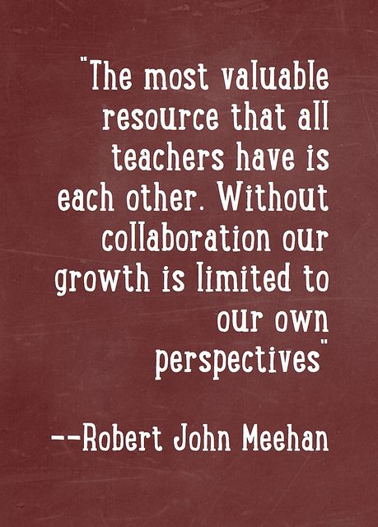
Concerns for Canyon Ridge staff and teachers in 2017-2018
Fewer ELL teachers…same number of ELL students
Change in role of ELL teacher
Access to equitable instruction in all content areas with general education peers and highly qualified teachers
Solution…
Friday Consulting Days with teachers
Notes:
Inspired by Co-planning Fridays from Kuna and Cherry Creek

Slide 9
Structure of Friday Consulting
Do not attend Co-taught classes, still teach pull-out classes
No overlap (one of us is available all day)
Co-planning with co-teachers
Cover for each other to consult in academic strengths and experiences

Slide 10
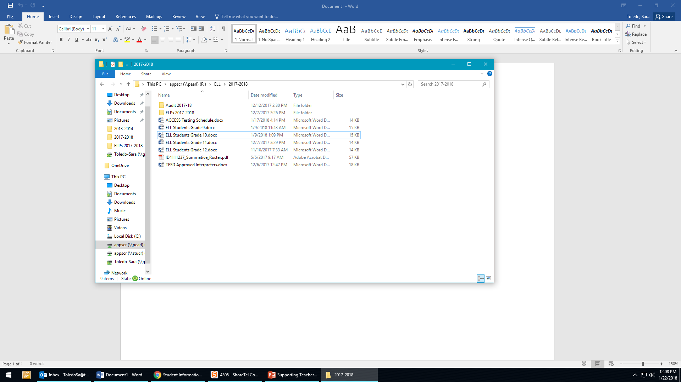
Coaching/Professional Development Offered by ELL teachers
Professional Development
Teaching strategies
Student background and education
Toolkits and Resources
- Milepost
- WIDA
School-level support
- R Drive documents
What we avoid offering: fix-it answers
Notes:
Explain that we avoid telling a teacher what to do. We want their decisions to be self-directed so they own it.

Slide 11
Marketing
Summer Institute Welcome Days
ELP signature hunting
Staff meetings
Word of mouth
E-mail (Looking forward to seeing you Friday)
Approachability

Slide 12
Approachability
Go to their comfortable space
Positivity
Positive presuppositions
Arrive with resources
- Individual Student ACCESS Reports
- WIDA Can-Do Descriptors
- Levels with Ideas for accommodations and modifications
- Examples of past assignments, materials

Slide 13
Make it Work: Implementation Advice
Friday, January 22
Buy – in: Everyone on board
(Admin, ELL teacher, Co-teacher)
Remind them of the opportunity
Accountability
Class Period | Teacher | Description
1st | Casella - Business | Reviewed class rosters, Milepost, WIDA levels and accommodations
2nd | Oneida - Science | Co-Planning
3rd | N/A
4th | Lauda - Science | Reviewed test adaptations, discussed audio accommodation project, Student rosters and para schedule
Leadership | N/A
LUnch | Johnson - Social Studies | Reviewed class rosters, identified ELL students, discussed assignment adaptations
6th | N/A
7th |  | Safe Schools Training
8th | Munoz | Co-planning

Slide 14
Canyon Ridge Teacher Feedback
“Having a relationship with our ELL professionals provides invaluable insight to the needs of my ELL students. They can help me better support students in my classes through suggesting assignment and test modifications, sharing teaching strategies to enhance understanding and engage students, and support planning and instruction as a co-teacher.”
“Consulting with ELL teachers during common prep time has allowed us to develop engaging and vocabulary-rich lessons.”

Slide 15
Value of an ELL Peer coach
With your table partner
- In what ways would this model benefit your teachers, both ESL and content teacher?
- What are some roadblocks to incorporating consulting at your school?
Other means of implementing peer consulting/resources:
- Office hours
- Google classroom
- Online discussion groups
- WIDA student portraits

Slide 16
Questions and Comments

Slide 17
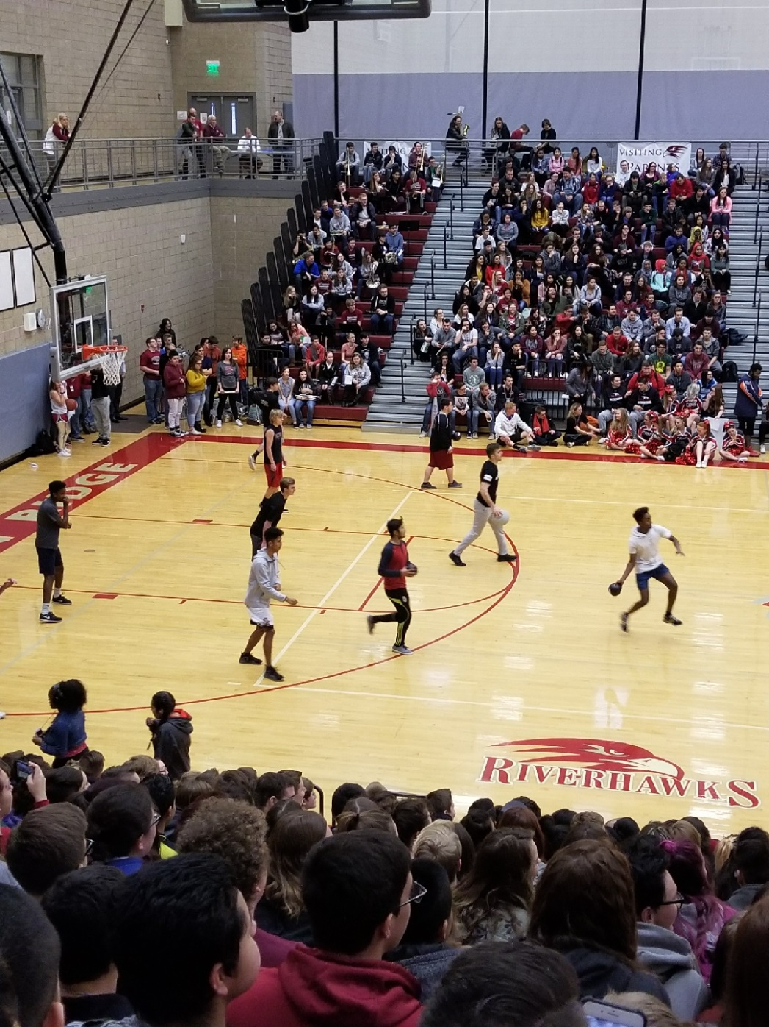
Closing and evaluation
“No man is an island,
Entire of itself,
Every man is a piece of the continent,
A part of the main…”
- John Donne

