Slide 1
Student Engagement Through Inquiry Based Learning
Christina Silva and Carly Heins
IABE 2018

Slide 2
Welcome!
Objectives:
Content: Educators will explore and present on multiple inquiry based teaching strategies that build background knowledge.
Language: Educators will discuss the importance of building background as it relates to language learners and other diverse learners.

Slide 3
Activity
Your group will receive one “support item.”
One person write down as much as you can to describe your support item.
When asked, count the number of words you have.
You will be asked to submit your words to the nearpod.

Slide 4
Importance of Building Background
Discuss at your table which support items resulted in more language and why.
This Photo by Unknown Author is licensed under CC BY-NC-SA

Slide 5
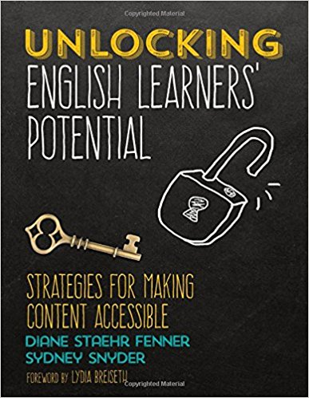
“Taking a few minutes to ‘jump-start’ students’ schema, finding out what they know or have experience about a topic, and linking their knowledge directly to a lesson’s objective will result in greater understanding for ELs.”
(Fenner & Snyder 177)

Slide 6
Gallery Walk
You will work in your group to create a poster on a specific inquiry based strategy.
Directions:
Learn about your given strategy with the provided resources and/or search for your own resources.
Create a poster that explains the strategy. Include the following: name of strategy, a brief description and directions on how to use, specific classroom examples, and an illustration.
After creating the posters, we will display the work and have a gallery walk.

Slide 7
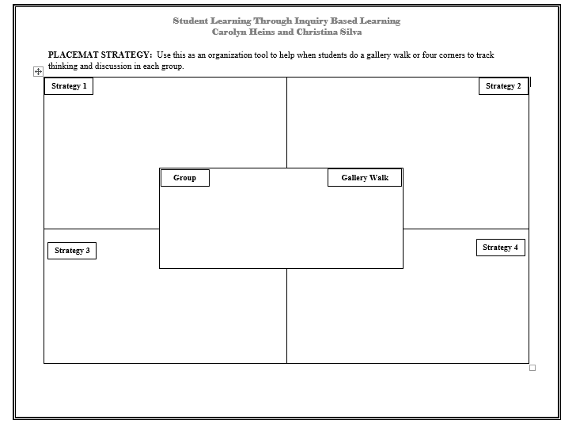

Slide 8
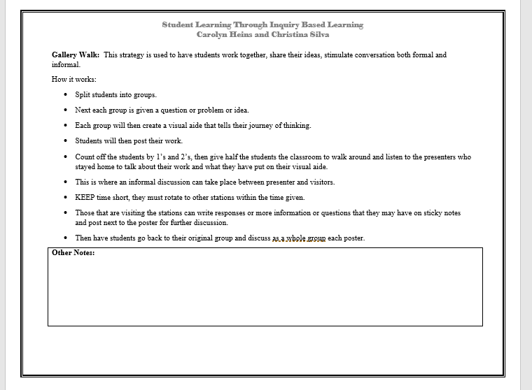

Slide 9
“The role of background knowledge cannot be ignored, and we truly believe it’s an issue of equity for ELs.”
(Fenner & Snyder 179)
This Photo by Unknown Author is licensed under CC BY-SA

Slide 10
References
Fenner, Diane Staehr, et al. Unlocking English Learners' Potential: Strategies for Making Content Accessible. Corwin, a SAGE Company, 2017.
Wilhelm, Jeffrey D., et al. Inquiring Minds Learn to Read and Write: 50 Problem-Based Literacy and Learning Strategies. Scholastic, 2009.

