Slide 1
Co-Teaching & Co-Planning
101
Alejandra Howell and
Kaitlin Johnson
Presenters

Slide 2
Co-Teaching:
All about
Apple
Sweaters

Slide 3
Co-Teaching and Co-Planning 101 Take
Aways
You will be able to:
Build a positive, and trusting relationship with your co-teacher.
Understand the six main types of co-teaching styles.
Set up your co-planning time.

Slide 4
Relationships and Co-Teaching

Slide 5
Relationships and Co-Teaching
If you cannot trust your co-teacher to do their part, you will not have an effective co-teaching relationship.
Ways to Build Trust:
Getting to know each other
Setting up expectations
Conflict resolution

Slide 6
Getting to Know Each Other
Why?
Relationships need a foundation
Being honest and upfront with our concerns puts them out in the open
Easier to work through conflict later on

Slide 7
Getting to Know Each Other
Knowing Myself and My Partner:
Take 5-10 minutes to fill out first 4 boxes
Discuss each box with your co-teaching partner
Take 5-10 minutes to fill out last two boxes and share with your partner

Slide 8
Getting to Know Each Other
Setting Up Expectations
Take your time filling out the question sheet individually
When finished, switch papers with your co-teacher and read through their responses
This is not the time to comment on your partner’s responses
Jot down thoughts you have in response to the questions
At the end, come back together with your co-teacher and discuss your reactions

Slide 9
Conflict Resolution
One of the most difficult parts of co-teaching
Unavoidable
Not a win/lose situation
Remember, co-teaching is a marriage

Slide 10
Conflict Resolution
Have a plan in place specifically for conflict
Knowing Myself and My Partner
Plan for a mediator
Be honest, but kind
Use “I” Messages
“When you __________, I feel ___________.”
Have a solution to suggest

Slide 11
The Six Co-Teaching Models
What is it?
“Co-teaching is two or more people sharing responsibility for teaching all of the students assigned to a classroom. It involves the distribution of responsibility among people for planning, differentiating instruction, and monitoring progress for a classroom of students.”
Nevin, a., Thousan, J., Villa, R. A., 2013

Slide 12
Supportive
One leads, One supports
One teacher takes primary responsibility for designing and delivering a lesson, while the other member of the co-teaching team provides support to some or all of the students in the classroom. This model can also be used for student/teacher observation with a purpose or specific reason.

Slide 13
Parallel
Two at Once
The class is divided in half. The co-teachers instruct, monitor, or facilitate the same lesson to the two separate heterogeneous groups at the same time.

Slide 14
Alternative
One Large, One Small
One co-teacher instructs the whole group, while the other takes a small group for intervention in the same room. This helps to monitor and facilitate varied groups.

Slide 15
Team, Complementary & Stationary
Team Teaching: Two is Better than One
Complementary: One Leads, One Models
Stationary: Divide and Conquer

Slide 16
Activity!
In your group:
Review your assigned co-teaching model
Plan a mini lesson to teach the model to others in the style of that model
You should cover the pros and cons of the model
Include a visual representation to facilitate understanding
You will have 5 minutes to plan, and 5 minutes to teach to others.

Slide 17
Collaborative Co-Planning
“Failing to plan, is a plan to fail.”
“In a co-teaching partnership, the desired outcome is the implementation of a co-taught differentiated lesson that results in student learning.”
Nevin, a., Thousan, J., Villa, R. A., 2013

Slide 18
Use the DELIVER tool to guide your co-planning:
Differentiation
Engagement of Students
Language & Content Objectives
Instructional Strategies
Varied Co-Teaching Models
Equity and Parity Established
Rigor

Slide 19
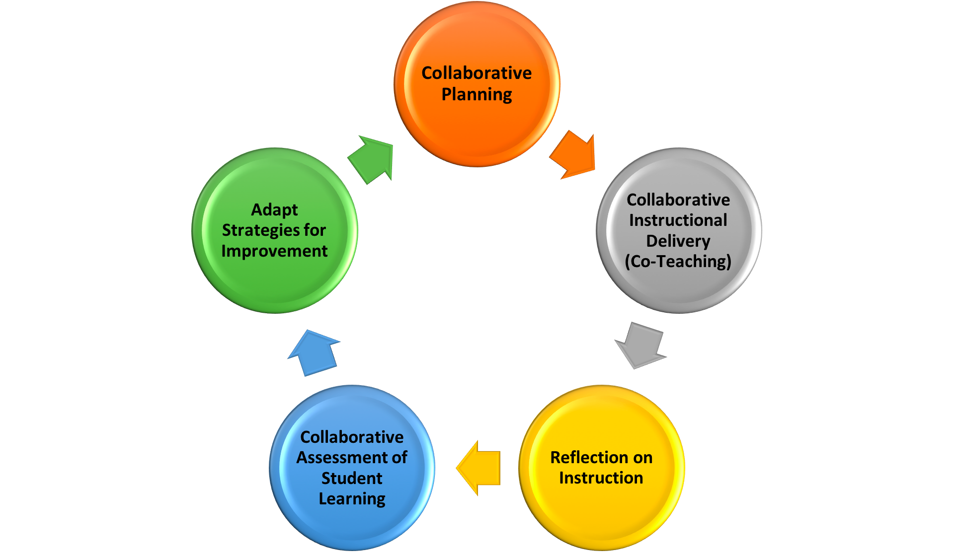
The Collaborative Instructional Cycle

Slide 20
Set up a hierarchy of steps to follow with your co-teachers when planning to optimize your time!
Consider the following:
Who is responsible for what before you meet?
When you meet, how will you write the plans?
How much time should you spend on each item?
Have you allowed time for reflection?
Have you allowed time for reviewing student work?
Have we used the Co-Teaching Self-Assessment Checklist for guidance?

Slide 21
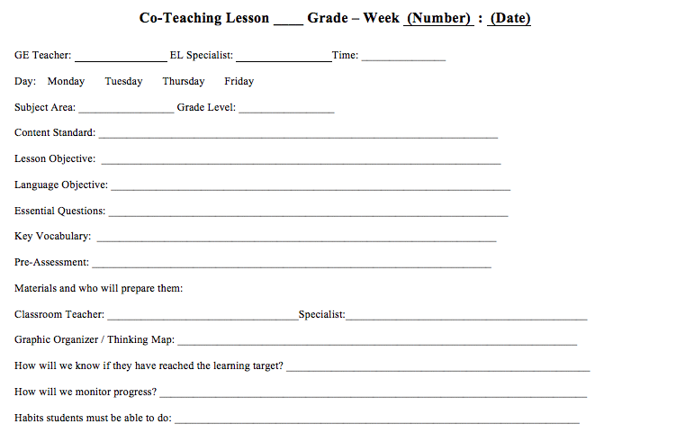
Sample Lesson Plan Template

Slide 22
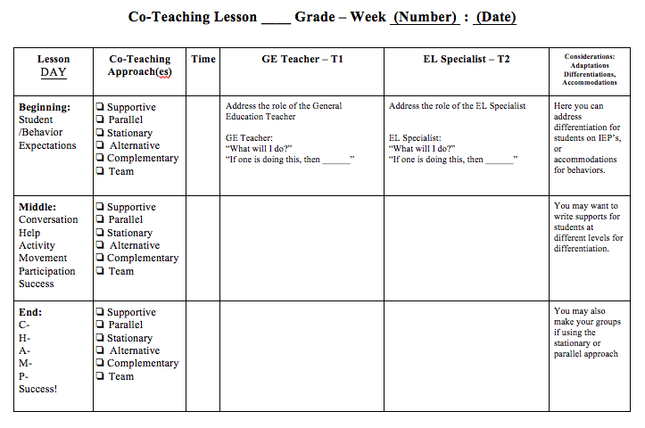
Sample Lesson Plan Template

Slide 23
Questions?

